Slide 1
A bill to prohibit the accounting for advertising expenses

Slide 2
On 27 November 2024, the Federation Council approved a bill to amend the rules for tax accounting of online advertising costs.
I. Explanation of amendments
The amendments affected clause 44 of Article 270 of the Tax Code of the Russian Federation (hereinafter referred to as the “TC RF”). The clause provides for the types of advertising costs that cannot be recognised as expenses when determining the profit tax base.
The bill sets forth that the following types of costs will not be recognised for tax purposes:
Internet advertising, which has not been reported to the Unified Register of Internet Advertising (hereinafter referred to as “URIA”) maintained by Roskomnadzor (the so-called advertising labelling);
advertising distributed on a website with access restricted under the laws of the Russian Federation;
advertising distributed on the information resources of foreign persons that violate the provisions of Federal Law No. 236-FZ dd. 01.07.2021 “On Activities of Foreign Persons in Internet Information and Telecommunications Network (hereinafter referred to as the “Law on Activities of Foreign Persons on the Internet”) on the Territory of the Russian Federation” and other provisions of the Russian legislation.
The amendments will become effective on the 1st day of the next tax period for profit tax, i.e. from 1 January 2025.
Currently, the TC RF provides for a limitation in the form of a standard of 1% of revenue to account for most advertising costs. It means that advertising costs are generally recognised for tax purposes within the established standard but not in the amount of actual costs incurred.
Meanwhile, Internet advertising costs are classified as non-standard costs. Therefore, such expenses can be recognised in full now, provided that they meet the general criteria for recognising costs, i.e. they are actually incurred, documented and economically justified (aimed at generating income).
From the beginning of 2025, costs for advertising placed in violation of the industry legislation or on prohibited resources will no longer be recognisable as it is directly prohibited by the TC RF.
#LegalAlert
W W W . V E R B A . L E G A L

Slide 3
#LegalAlert
II. Assessment of amendments
On the one hand, the amendments of the TC RF are aimed at aligning the provisions of the TC RF in terms of accounting for advertising costs and industry legislation, which has recently introduced several material limitations on the distribution of online advertising.
On the other hand, it is not clear how the initiative correlates with the principle of “fiscal neutrality”, which stipulates that a violation of industry legislation by taxpayers should not affect their tax liability.
Furthermore, please note that the list of limitable costs is described quite broadly and actually suggests that advertising costs of a foreign entity will not be recognized not only if the latter violates advertising legislation, but also if it violates any other Russian laws as well.
In view of such limitations, potential attempts of tax authorities to reclassify other types of advertising costs as limitable costs should not be ruled out.
W W W . V E R B A . L E G A L

Slide 4
Contacts
/ Evgeniia Zainchukovskaia
Counsel
evgeniia.zainchukovskaia@verba.legal
Младший юрист
/ Andrey Sheptiy
/ Altana Lidzhieva
Senior associate
Paralegal
andrey.sheptiy@verba.legal
altana.lidzhieva@verba.legal

Slide 5
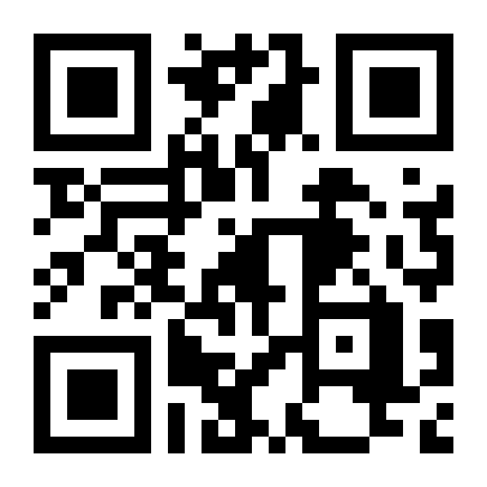
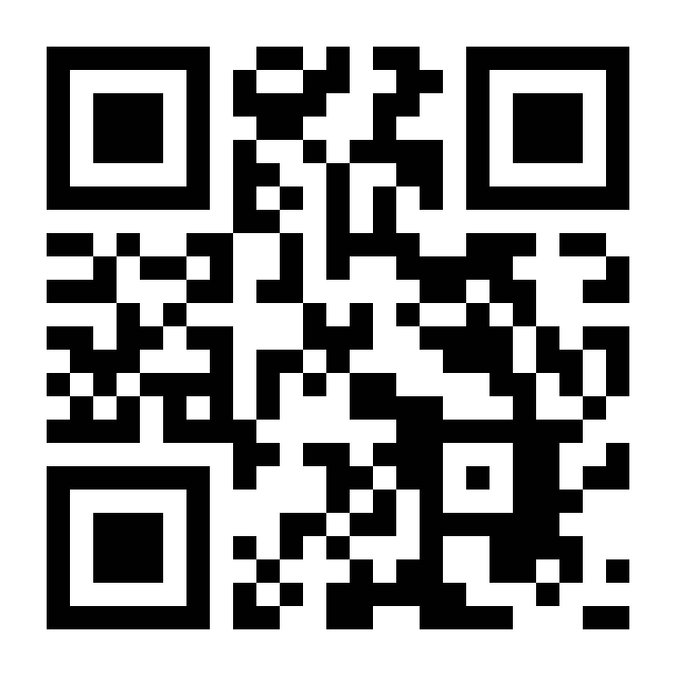
info@verba.legal
+7 (495) 374-74-03
11 Gogolevsky Boulevard, Moscow, 119019
t.me/verbalegal
t.me/ma_nagogolevskom

